Slide 1
NFL Pro Bowl QBs
By Robby Dayton, Jackson Hardin, Nico Gabriel, Derek Wagner, and Walt Young

Slide 2
Our Data Set
Found from the nflscrapR Package; narrowed down to 422 observations over 10 years (no missing values)
14 predictors (10 of them continuous)
Goal: to produce a model which accurately predicts which 6 quarterbacks make the Pro Bowl each year
Reliance on simple statistics/why this may not be a problem
Who selects the Pro Bowl QBs?
What other considerations might impact a player’s chances of making the “big game”?
How indicative are Pro Bowl results of a player’s actual value?
Notes:
train/test splits

Slide 3
Variable Selection
Treated as a regression problem for variable selection
Used 3 metrics for determining which variables were best
Mallow’s Cp, BIC, Adj. R^2
Used the 9 variables suggested by Adjusted R^2
Everything except fumbles and rushing touchdowns
Also tried models using only 2 variables
Passing touchdowns (continuous) and playoffs (categorical)
Notes:
In between: Derek talks about basic logistic regression
Bad; various cutoff values, none get over 86% accuracy

Slide 4
LDA and QDA Methods
Both LDA and QDA performed pretty well
LDA actually had a lower misclassification rate compared to QDA
Likely due to QDA overfitting the data set
Cross-validated misclassification rates are 0.07831949 and 0.1041141 for LDA and QDA, respectively (using 10-fold cross-validation)
LDA and QDA are global methods
Notes:
Flexible vs inflexible global

Slide 5
Splines and GAMs
When working with GAMs, tends to overfit
Putting together a generalized additive model for original predictors
Leads to an accuracy rate of about 84%
However, cutting predictors down to passing touchdowns & the playoff starter variable produces an accuracy rate of about 90%
Similar fitting issues when it came to splines
Notes:
GAMs overfit (flexible) same as QDA

Slide 6
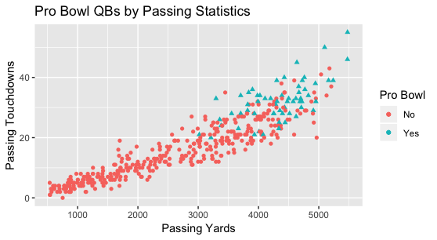
kNN
kNN is a method that gave us exciting results
As a local method, kNN is an intuitive choice of technique

Slide 7
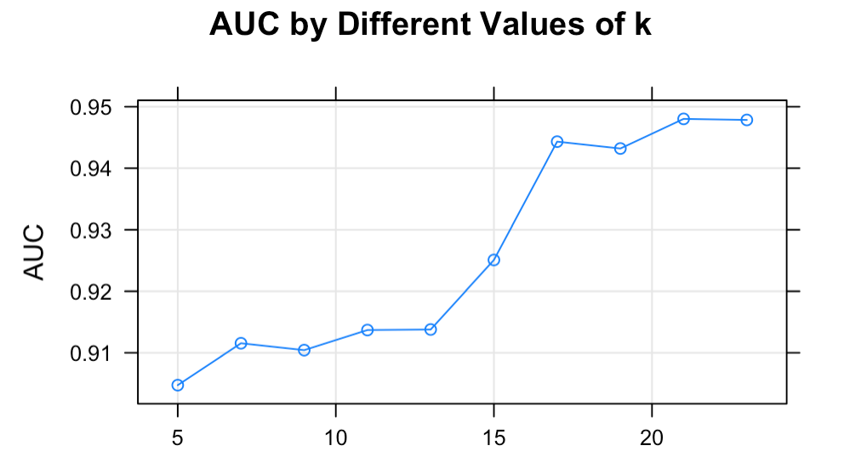
kNN
We performed 10-fold cross-validation on a full model (all predictors considered)
Optimal model: k = 21
Specificity: .976
Sensitivity: .650
Overall, kNN provided high accuracy, but the poor specificity number indicates that we are predicting more Pro Bowl quarterbacks than there actually are

Slide 8
Going Further with kNN
Restricted data to only QBs with >300 attempts
Actually more accurate than first model
Used reduced predictor set
Removed rushing touchdowns and fumbles lost to match with earlier model selection
Produced model (k = 21) with AUC = .946, sensitivity = .670, specificity = .976
Misclassification rate of 6.80% (better than LDA!)
Also made model with both reduced n and reduced p
Not as good as other models, but comparable

Slide 9
Random Forests
Variable | Avg. MSE improvement
pass.tds | .054
pass.yds | .041
playoff | .025
pass.comp | .021
Changed from simple majority vote
Need >P probability of making Pro Bowl to be classified as such
Our best model
9 variables - 4.7% misclassification, P=.6, 4000 trees, mtry = 3
2 variables - 4.7% misclassification, P=.8, 2000 trees, mtry = 2
Same confusion matrix
Assumed high collinearity between important variables
Bagging underperformed both models
 | Not Pro Bowl | Pro Bowl
Not Pro Bowl | 89 | 3
Pro Bowl | 2 | 12

Slide 10
Conclusions
Both global and local methods can provide good solutions to a problem
LDA vs random forests
Reducing model complexity can have surprising results
Using only 2 predictors gave equally predictive results as using 9
Bias-variance trade off should be considered
LDA vs QDA
Media is substance-free echo chamber

